Slide 1

Fake news detection project
By Ashok Kumar Sharma

Slide 2
ACKNOWLEDGMENT
I would like to express my deep sense of gratitude to my SME (Subject Matter Expert) Ms. Rashi Mathur as well as Flip Robo Technologies who gave me the golden opportunity to do project on Fake News Detection, which also helped me in doing lots of research and I came to know about so many new things.
I am very much thankful to Mr. Shankargouda Tegginmani, Trainer (DataTrained), for their valuable guidance, keen interest and encouragement at various stages of my training period which eventually helped me a lot in doing this project.
I also acknowledge with thanks for suggestion and timely guidance, which I have received from my SME Ms. Rashi Mathur during this project, which immensely helped me in the evaluation of my ideas on the project.
Ashok Kumar Sharma

Slide 3
introduction
Business Problem Framing
The authenticity of Information has become a longstanding issue affecting businesses and society, both for printed and digital media. On social networks, the reach and effects of information spread occur at such a fast pace and so amplified that distorted, inaccurate, or false information acquires a tremendous potential to cause real-world impacts, within minutes, for millions of users. Recently, several public concerns about this problem and some approaches to mitigate the problem were expressed. This project is intended to build a model which can predict whether the news is fake or not.

Slide 4
introduction
Conceptual Background of the Domain Problem
Fake news is false or misleading information presented as news. It often has the aim of damaging the reputation of a person or entity, or making money through advertising revenue. However, the term does not have a fixed definition, and has been applied more broadly to include any type of false information, including unintentional and unconscious mechanisms, and also by high-profile individuals to apply to any news unfavourable to his/her personal perspectives.

Slide 5
introduction
Review of Literature
What is Fake News?
Fake news is false or misleading information presented as news. It often has the aim of damaging the reputation of a person or entity, or making money through advertising revenue.

Slide 6
introduction
Motivation for the Problem Undertaken
This model can be used by the print media, news media, social media and search engine websites to detect a news article as Fake or Not Fake. This model can classify fake news so that it can be controlled and restricted from spreading around the world.

Slide 7
Analytical Problem Framing
Mathematical/ Analytical Modeling of the Problem
For checking datatypes and null values, pandas.DataFrame.info() and pandas.Series.isnull().sum() method has been used. To drop the null values pandas.DataFrame.dropna() method has been used. To replace and remove the certain terms and punctuations, pandas.Series.str.replace() method with regular expression has been used. To get rid of stop words, nltk.corpus.stopwords() method has been used.

Slide 8
Analytical Problem Framing
Data Inputs- Logic- Output Relationships
Input | Logic (algorithm) | Output
text_feature (object) | MultinomialNB SGDClassifier HistGradientBoostingClassifier | 0 Or 1
There is 1 input variable needs to be provided to the logic to get the output i.e. 0-NotFake or 1-Fake. Logic highlighted i.e. HistGradientBoostingClassifier is the best performing algorithm among all other logics on this dataset.

Slide 9
Analytical Problem Framing
Data Sources and their formats
The dataset is in the form of .CSV (Comma Separated Value) format and consists of 6 columns (5 features and 1 label) with 20800 number of records as explained below:
The data set includes:
id: Unique id for each news article.
headline: It is the title of the news.
news: It contains the full text of the news article.
Unnamed: 0: It is a serial number.
written_by: It represent the author of the news article.
label: It tells whether the news is fake(1) or not fake(0).

Slide 10
Analytical Problem Framing
Data Preprocessing Done
The following pre-processing pipeline is required to perform model prediction:
Load dataset.
Drop column Unnamed: 0 and id.
Treating Null Values: Replace null values with ' ' (single space) and merging feature headline, written_by and news to new column text_feature and then dropp columns headline, written_by and news.
Convert text_feature to lower case and replace '\n' with single space.
Keep only text data i.e., a-z’ and 0-9 and remove other data from text_feature.
Remove stop words and punctuations
Covert text_feature to vectors using TfidfVectorizer.
Load saved or serialized model
Predict values by passing the vectors of text_feature.

Slide 11
Analytical Problem Framing
Hardware and Software Requirements and Tools Used
During this project following set of hardware is being used: RAM: 8 GB PAGE_FILE: 90 GB of SSD CPU: AMD A8 Quad Core 2.2 Ghz GPU: AMD Redon R5 Graphics and the following software and tools is being used: Python Jupyter Notebook Anaconda | With following libraries and packages: Pandas Numpy Matplotlib Seaborn nltk wordcloud sys Timeit tqdm.notebook sklearn

Slide 12
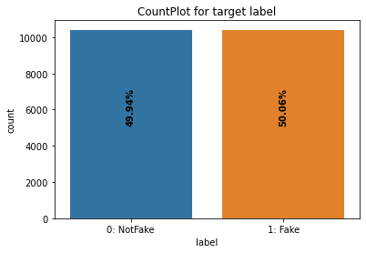
Exploratory Data analysis (eda) & visualization
Univariate Analysis
Univariate analysis is the simplest form of data analysis where the data being analyzed contains only one variable. In this project, distribution plot, count plot, box plot and bar plot has been used.
Count Plot:
Remarks:
There are almost equal number of records available for fake (1) and Not Fake (0) label.
Dataset is balanced.

Slide 13
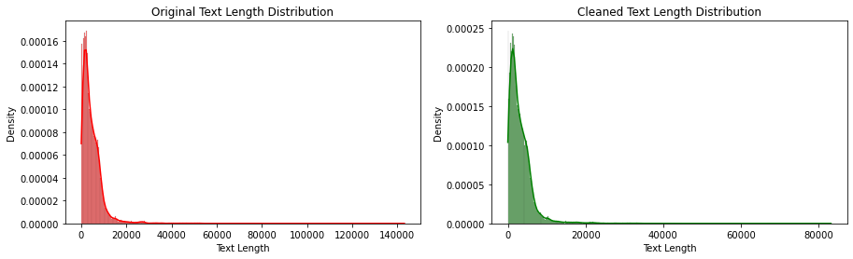
Exploratory Data analysis (eda) & visualization
Univariate Analysis: Distribution Plot
Remarks:
From the above dipiction, it is clear that the length of text reduced by greater amount after cleansing of text data.
Also, the range of text length reduced from 0-140000 to 0-80000.

Slide 14
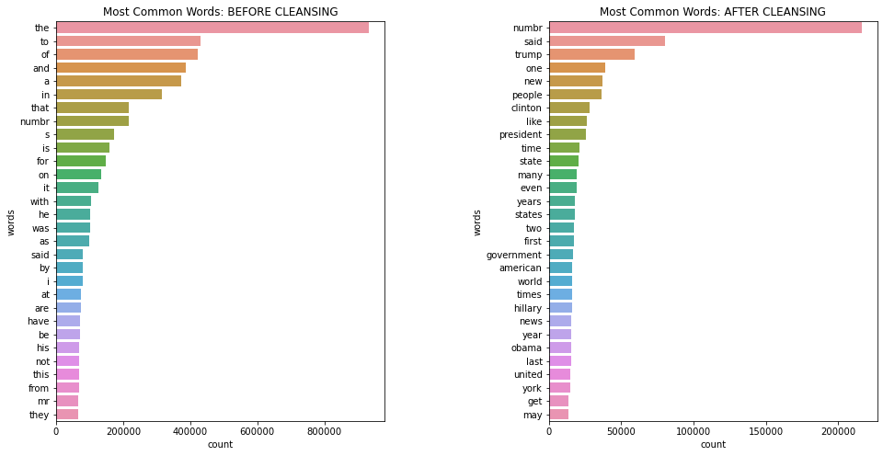
Exploratory Data analysis (eda) & visualization
Univariate Analysis: Bar Plot
Remarks:
From above depiction, it is clear that the most common words before cleansing were the, to, of, and, a, etc. while after cleansing most common words are numbr, trump, one, new, people, etc.

Slide 15
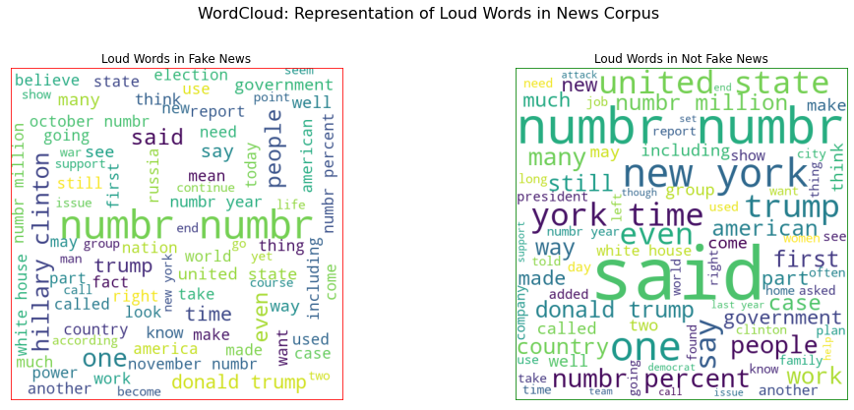
Exploratory Data analysis (eda) & visualization
Word Cloud : Display
Remarks:
Loud words in Fake news are numbers, hillary clinton, donald trump, america, united state, people, war, etc.
Loud words in Not Fake news are new york, trump, united state, support, help, democrat etc.

Slide 16
Exploratory Data analysis (eda) & visualization
Concluding Remarks
Starting with count plot, it was found that dataset is balanced with almost equal number of records for fake news as well as not fake news. Moving further with distribution plot for news text length, it was found that after cleansing of news text, the length of news text reduced by a greater amount. Also with the help of barplot for most common words, it was found that, before cleansing, the most common words are mostly stop words i.e. the, and, of, a, etc. and after cleansing, the most common words are like, numbr, said, clinton, people, president, time, state etc. With the help of word cloud, it was found that the loud words in fake news are hillary clinton, donald trump, america, united state, war etc. while in not fake news are new york, trump, united state, support, help, demorat etc.

Slide 17
Model/s Development and Evaluation
Identification of possible problem-solving approaches (methods)
To solve this problem, following steps are used:
Load dataset.
Drop column Unnamed: 0 and id.
Treating Null Values: Replace null values with ' ' (single space) and merging feature headline, written_by and news to new column text_feature and then dropp columns headline, written_by and news.
Convert text_feature to lower case and replace '\n' with single space.
Keep only text data i.e., a-z’ and 0-9 and remove other data from text_feature.
Remove stop words and punctuations
Covert text_feature to vectors using TfidfVectorizer.
Separate Input and Output/Target Variables
Train & Test the Model by supplying Input and Output Variables.

Slide 18
Model/s Development and Evaluation
Testing of Identified Approaches (Algorithms)
Following are the list of algorithms used for training and testing:
MultinomialNB
SGDClassifier
HistGradientBoostingClassifier

Slide 19
Model/s Development and Evaluation
Run and Evaluate selected models
A total of 3 algorithm has been used on this dataset for training testing purpose, these are MultinomialNB, SGDClassifier and HistGradientBoostingClassifer. From the model performance comparison it is clear that HistGradientBoostingClassifer out-performs the other models with accuracy_score of 98.03% and log loss: 0.67. Therefore, continuing with HistGradientBoostingClassifer as final model.

Slide 20
Conclusion
Key Findings and Conclusions of the Study
HistGradientBoostingClassifier performs better with Accuracy Score: 98.03% and Log Loss: 0.67 than other models. Therefore, proceeding with HistGradientBoostingClassifier.

Slide 21
Conclusion
Learning Outcomes of the Study in respect of Data Science
During the data analysis, I have replaced the null values with single white space and then merge the feature headline, news, written_by to make a single feature text_feature and then dropped the feature headline, news and written_by. But these null values can also be removed by dropping the entire row and proceed further without merging the features into single feature which might impact the model performance either in positive or negative way. As of now, I am finishing this project with my current approach which gives the final accuracy score of 98.03% and log loss: 0.67 and this can be further improved by training with more specific data.

Slide 22
Conclusion
Limitations of this work and Scope for Future Work
Current model is limited to news data but this can further be improved for other sectors of fake document detection by training the model accordingly. The overall score can also be improved further by training the model with more specific data.

